Slide 1

Sales Performance Analysis Using Excel
Insights from Regional, Product, and Customer Data
Dinesh | August 2025

Slide 2

Project Overview
Dataset Scope
Sales transactions across regions, products, reps, customer types, delivery status.
Objective
Analyse performance, identify trends, generate actionable insights.

Slide 3




Excel Tools Utilised
PivotTables
Formulas
Summarising large datasets.
Calculations (SUMIFS, VLOOKUP, IF).
Conditional Formatting
Charts
Highlighting key trends.
Visual storytelling (bar, pie, line).

Slide 4

Key Performance Metrics
₹504,462
₹88,074.85
Total Sales
Total Profit
₹30.06
2,930
Avg. Profit/Unit
Total Units Sold

Slide 5
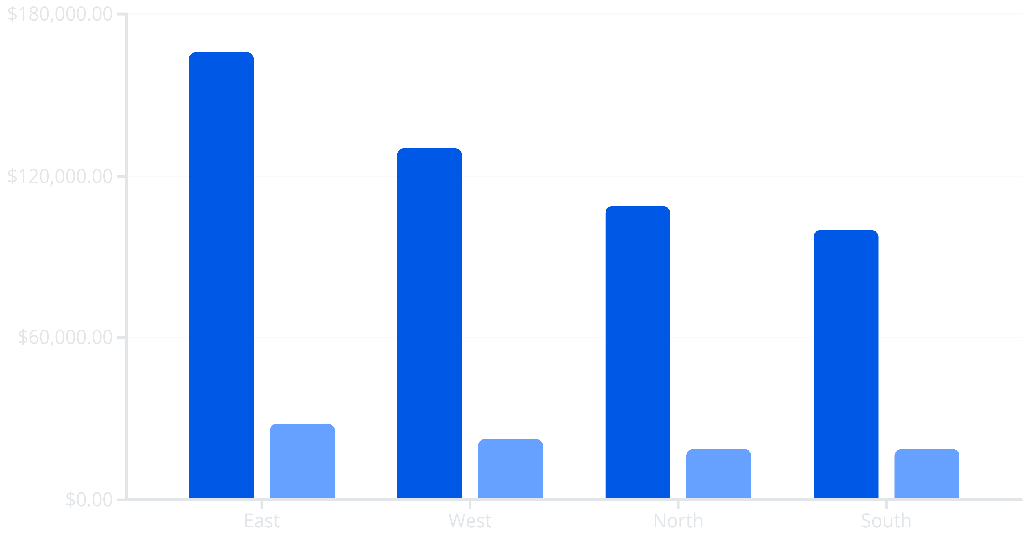
Regional Sales Performance
Sales
Profit
East region leads in both sales and profit, indicating strong market presence.

Slide 6
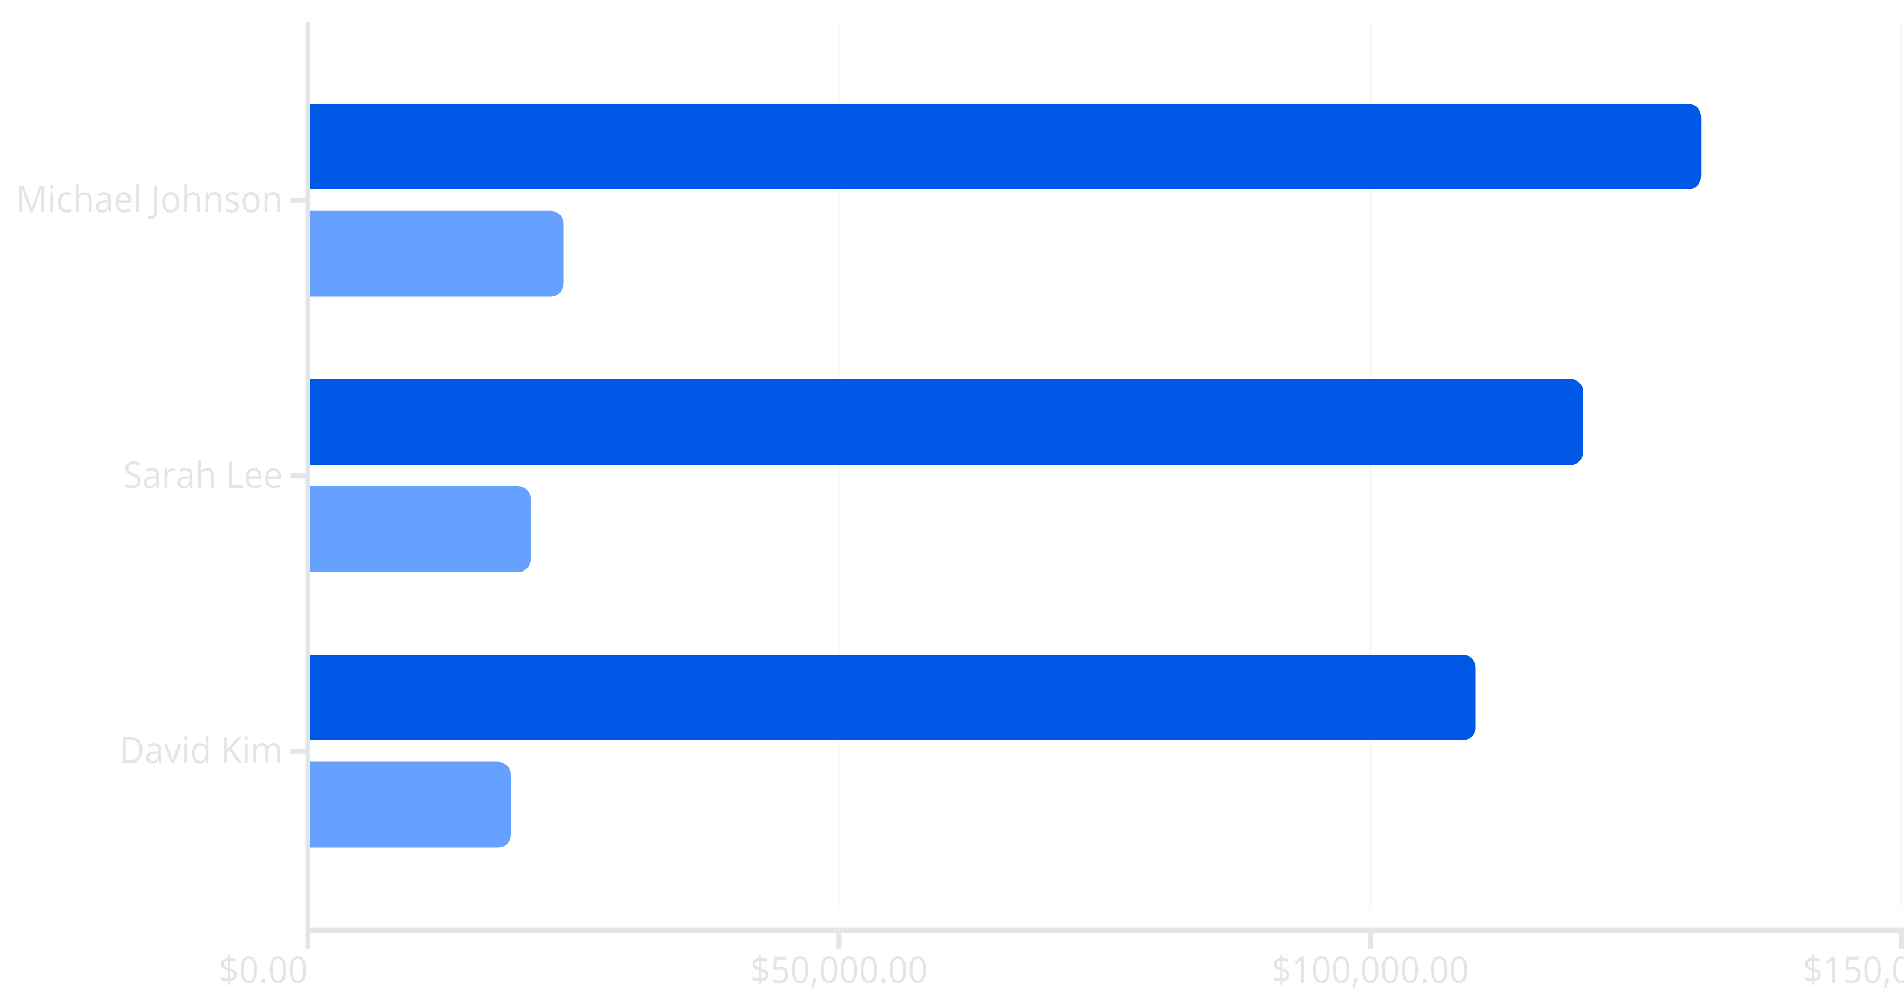
Top Sales Representatives
Sales
Profit
Michael Johnson is the top-performing sales representative.

Slide 7
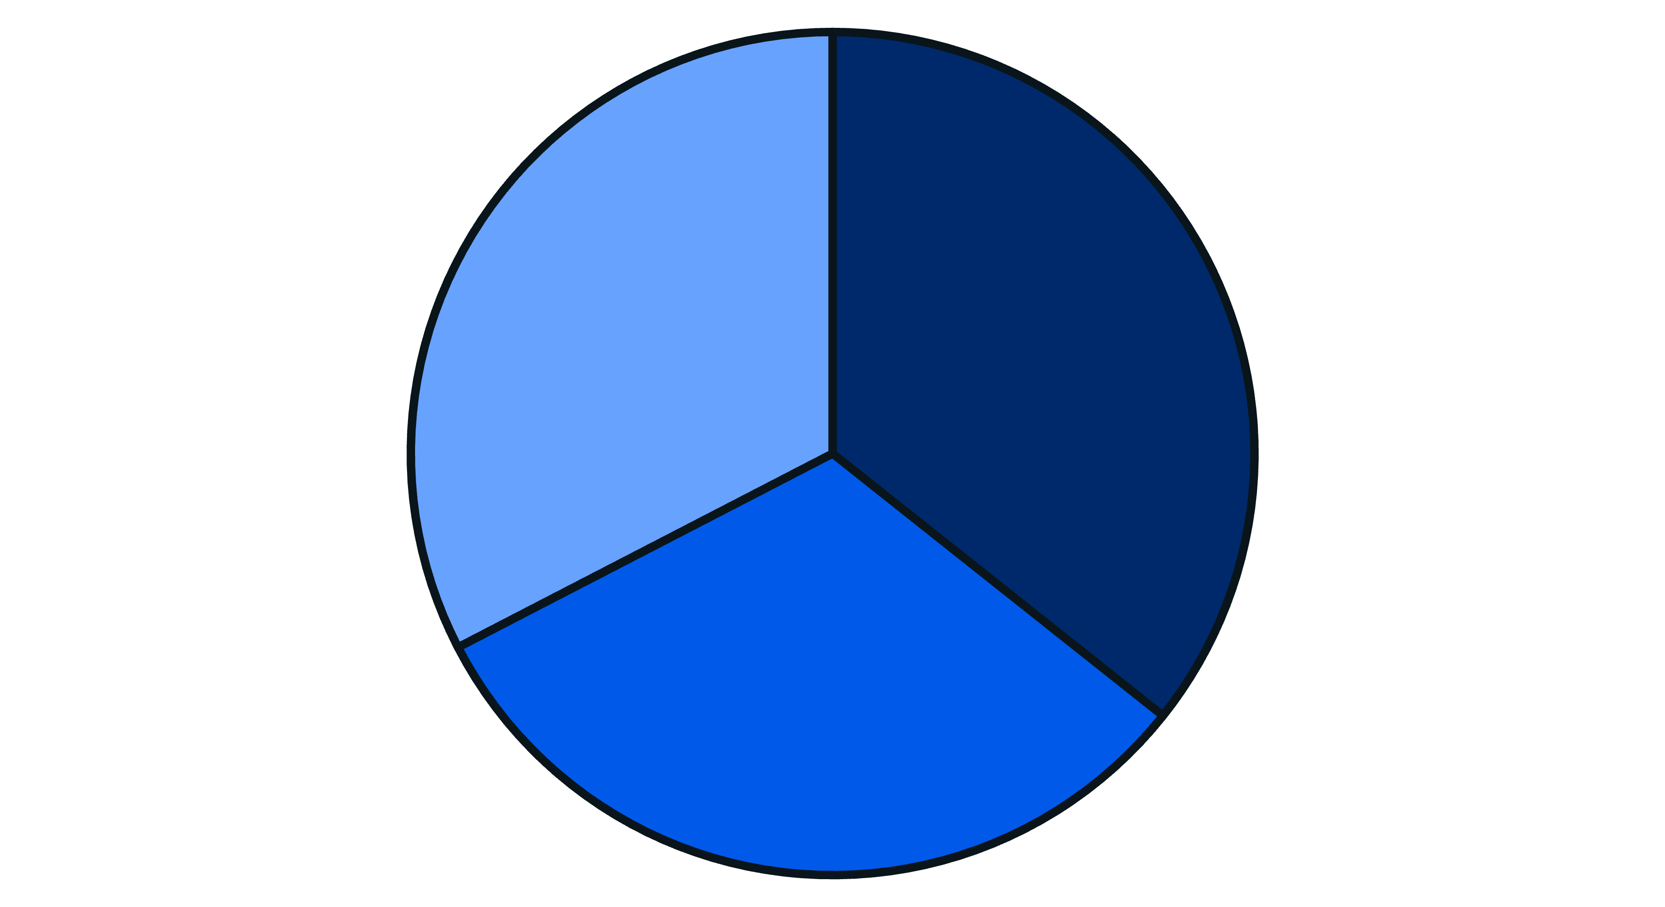
Product Category Breakdown
Appliances
Clothing
Sports
Appliances category yields the highest profit, followed by Sports and Clothing.

Slide 8

Customer Insights
New Customers
Returning Customers
New customers drive sales volume, while returning customers contribute significantly to profit margins.

Slide 9

Key Findings & Recommendations
Key Findings
Recommendations
East region leads in sales & profit.
Focus marketing on East region.
Michael Johnson: top sales rep.
Promote high-margin products (Appliances).
Appliances: highest profit category.
Improve delivery pipeline.
New customers drive volume, returning customers drive margin.

Slide 10
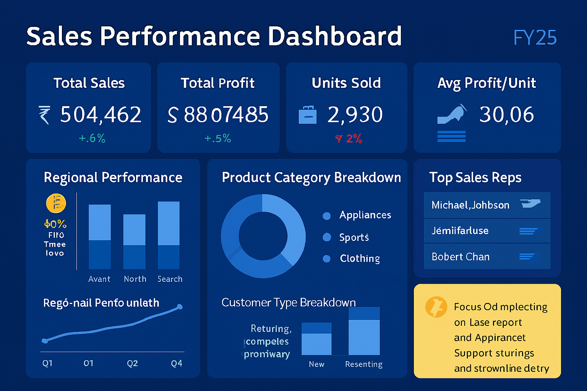

Slide 11

Conclusion & Next Steps
01
02
03
Recap Insights
Further Analysis
Contact
Summarise key findings from analysis.
Customer segmentation, forecasting models.
Dinesh | Email / GitHub (Optional)
Thank you!

